Slide 1
Inferences from Hate speech detection on online platform dataset

Slide 2
#INFERENCES
From the results of word frequencies, word embeddings, and topic modeling, we can derive several insights:
Word Frequencies:
The most frequent words in the text data provide insights into the common topics or themes present in the content.
In this dataset, words like "white," "like," "people," "would," and "get" are among the most frequent words. These words may be indicative of common topics discussed in the text, such as race, opinions, and actions.
Topic Modeling:
Topic modeling identifies underlying topics or themes present in the text data.
of words that frequently co-occur in the text data. For example:
Topic 0: Personal Experiences and Observations:
Topic 1: Social Issues:
Topic 2: Education and Family:
Topic 3: Time and Regular Occurrences:
Topic 4: Opinions, Desires, and Social Dynamics:

Slide 3
Based on the sentiment analysis results:
Overall Sentiment Score: The overall sentiment score for the entire dataset is approximately 0.0486, indicating a slightly positive sentiment on average across all texts.
Average Sentiment for Hate Speech Instances: The average sentiment score for texts labeled as hate speech is approximately -0.0985, which suggests a negative sentiment associated with these instances. This aligns with the expectation that hate speech often contains negative or offensive language.
Average Sentiment for Non-Hate Speech Instances: The average sentiment score for texts labeled as non-hate speech is approximately 0.0688, indicating a slightly positive sentiment associated with these instances. This suggests that non-hate speech instances tend to have a more neutral or positive tone compared to hate speech instances.
These results provide insights into the sentiment distribution within the dataset and highlight the differences in sentiment between hate speech and non-hate speech instances. Negative sentiment scores for hate speech instances underscore the importance of identifying and addressing hateful content in online platforms.

Slide 4
Based on Sample hate speech
Content Description: The hate speech texts contain derogatory and offensive language directed towards certain groups, including racial and religious minorities.
Negative Sentiment: The sentiment expressed in these texts is overwhelmingly negative. This aligns with the sentiment analysis results, where hate speech instances had an average sentiment score of approximately -0.0985.
Themes and Topics:
Racial and Ethnic Bias: The texts contain references to racial stereotypes and prejudices, such as derogatory remarks about Blacks and Jews.
Cultural Intolerance: There is a theme of cultural intolerance, with expressions of disgust towards certain communities and assumptions about their behavior.
Violence and Hatred: Some texts contain threats or expressions of violence towards certain groups, indicating a deeply ingrained sense of hatred.
Impact: The language used in these texts can be harmful and contribute to the propagation of discriminatory attitudes and behaviors. It can also create a hostile environment for targeted groups and perpetuate social divisions.
Contextual Understanding: Analyzing the sentiment in conjunction with the text content provides context around the emotional intensity and severity of the hate speech.
Understanding the context helps in assessing the severity of the hateful content and devising appropriate strategies for mitigation and intervention

Slide 5
#USER PROFILING
Top Features Associated with Hate Speech Propensity:
Feature Coefficient
3031 negroes 3.053553
4465 they 2.559058
2433 jews 2.553608
341 ape 2.378900
3030 negro 2.348306
3901 scum 2.150293
2965 mud 2.129642
2430 jew 2.009363
4464 these 1.788492
4993 zionist 1.738630
user_id posting_frequency
0 572033 4
1 572036 1
2 572037 3
3 572041 2
4 572042 13
... ... ...
2787 758788 4
2788 760015 1
2789 775309 2
2790 790048 3
2791 796449 3
[2792 rows x 2 columns]
Maximum posting frequency: 248

Slide 6
Correlation between Posting Frequency and Engagement Metric: 0.935615390141014
#INFERENCES
A correlation coefficient of 0.9356 indicates a strong positive correlation between posting frequency and the engagement metric.
This suggests that users who post more frequently tend to have higher engagement metrics, which is intuitive. In other words, as posting frequency increases,
so does the engagement metric, and vice versa.
This strong positive correlation implies that users who are more active in posting content also tend to have higher engagement levels,
as measured by the combined metric of posting frequency and content length.

Slide 7
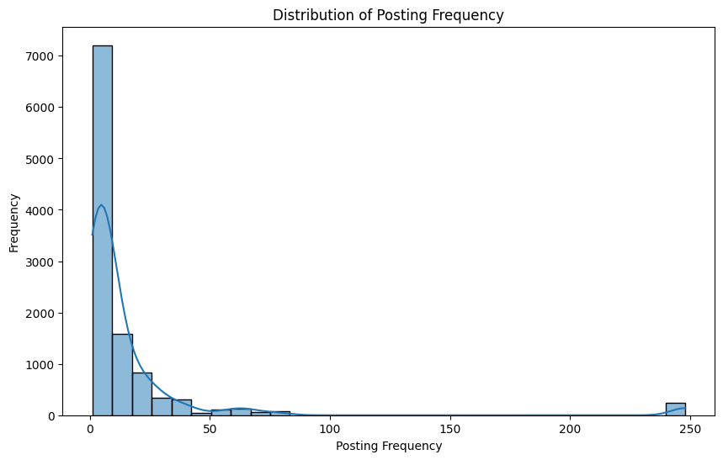
Descriptive Statistics of Posting Frequency:
count 10944.000000
mean 16.217471
std 37.848564
min 1.000000
25% 3.000000
50% 6.000000
75% 13.000000
max 248.000000
Name: posting_frequency, dtype: float64

Slide 8
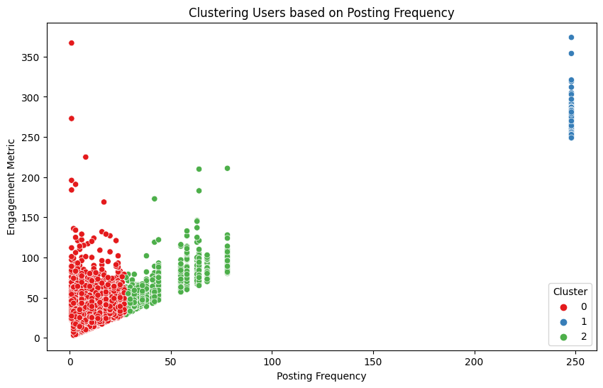
Comparison of Posting Frequency Across User Categories:
user_id
572033 4.0
572036 1.0
572037 3.0
572041 2.0
572042 13.0
...
758788 4.0
760015 1.0
775309 2.0
790048 3.0
796449 3.0

Slide 9
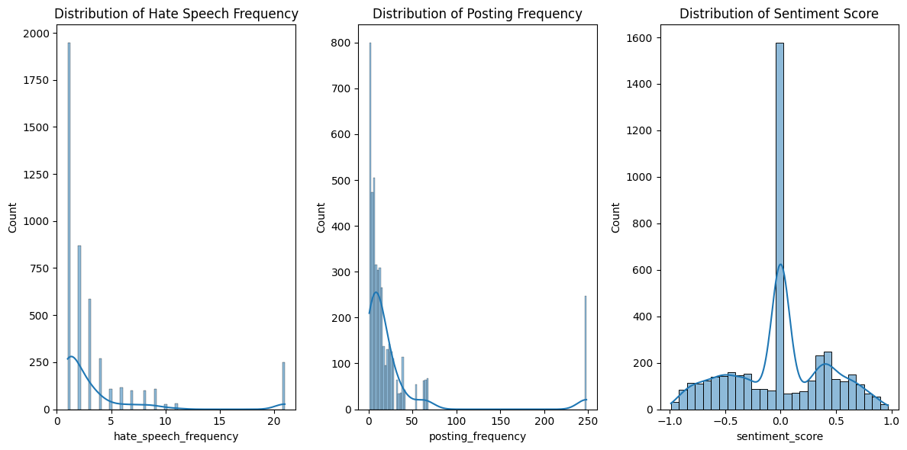

Slide 10
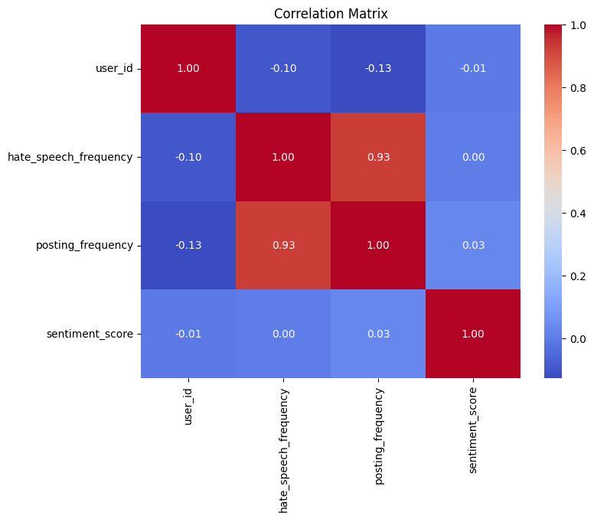
correlation b/w hate speech frequency and posting frequency =0.93

Slide 11
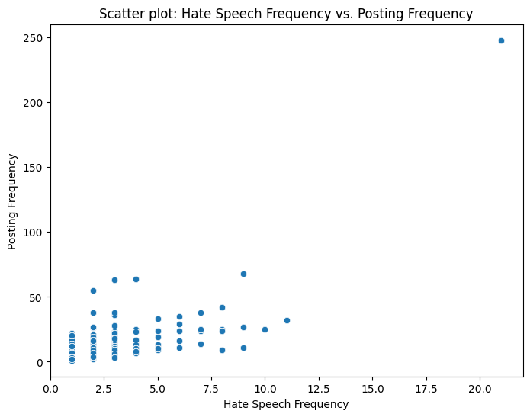

Slide 12
#Geospatial Analysis
Top 5 Locations of Hate Speech Occurrences:
Location Hate Speech Count
52 Ireland 99
45 Canada 57
80 Whites 41
16 London 41
21 America 34

Slide 13
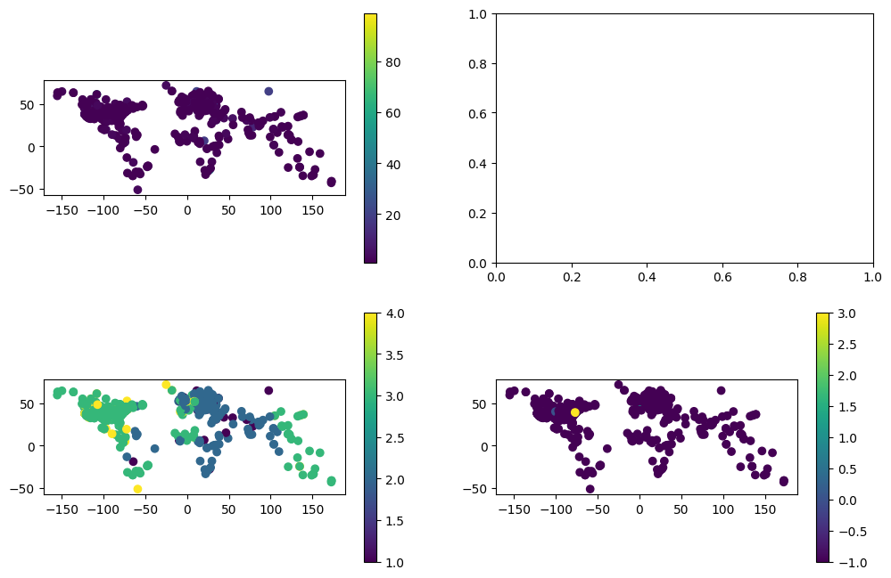
The first subplot displays the distribution of hate speech frequency across locations.
The second subplot displays the local spatial autocorrelation clusters identified by the Local Moran's I analysis.
The third subplot displays the spatial clusters detected by the DBSCAN algorithm based on the latitude and longitude coordinates.

Slide 14
Input data shape: (10944, 100)
Labels shape: (10703,)
Adjusted input data shape: (10703, 100)
Adjusted labels shape: (10703,)
(10703, 1, 100)
(10703, 1)
#INFERENCES(using tensorflow library)
Test Loss: The loss value, which indicates how well the model is performing on unseen data. A lower loss value is desirable, as it indicates better performance.
Test Accuracy: The accuracy of the model on the test dataset. It represents the proportion of correctly classified samples out of the total number of samples in the test dataset. Higher accuracy indicates better performance.
In this case, the model achieved a test loss of approximately 0.077 and a test accuracy of approximately 97.26%. These results suggest that the model performs well on unseen data and is effective in making accurate predictions after addressing the class imbalance issue.

